Slide 1
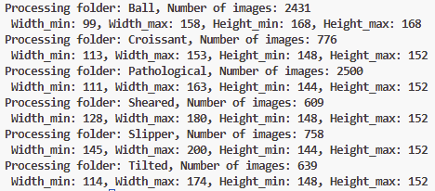
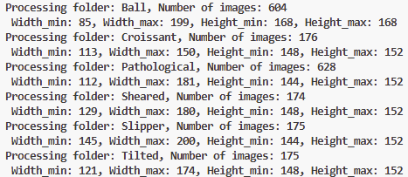
Statistical Analysis
Training Set
≈ 4 : 1
Validation Set
Training Set: max_width=200, max_height=168
Validation Set: max_width=200, max_height=168
Zero-padding to make sure each image have the same width and height.
Three channels image transform into single channel grayscale image with PIL.Image.new(‘L’) function.
[width, height] = [200, 168]
Training Settings
5-fold cross-validation on the training set (prevent overfitting).
By selecting the highest-accuracy of each fold, save the model’s checkpoint.
Then testing on the validation set.
Rename the ‘Validation’ as ‘Test’.

Slide 2
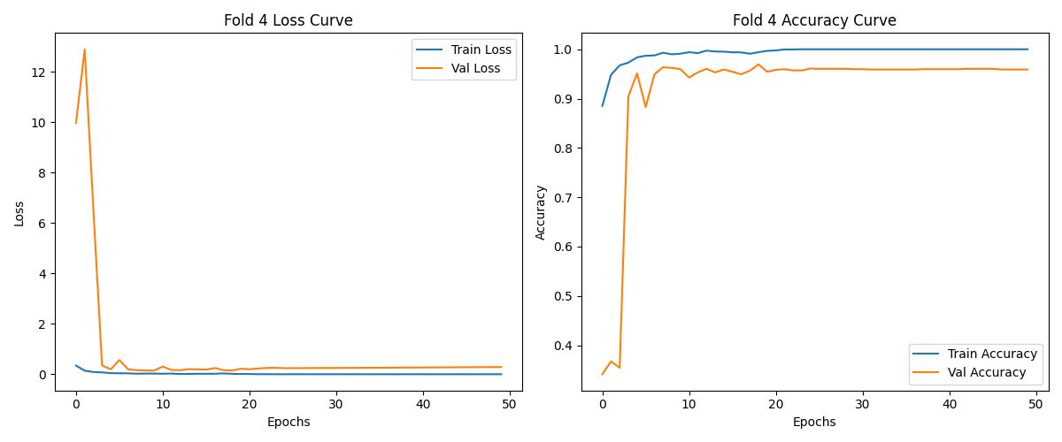
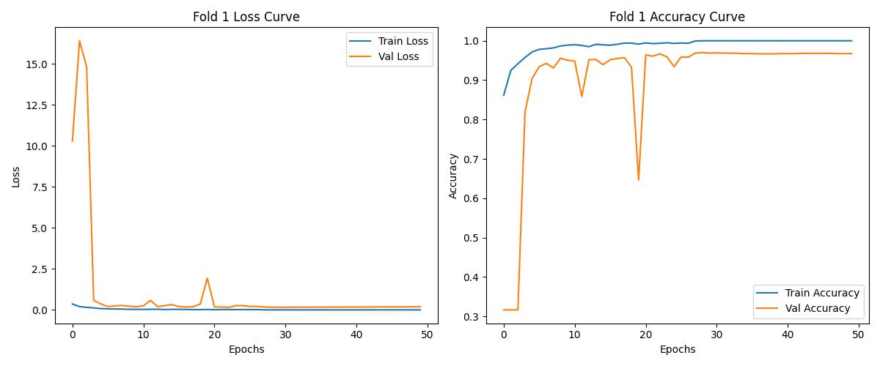
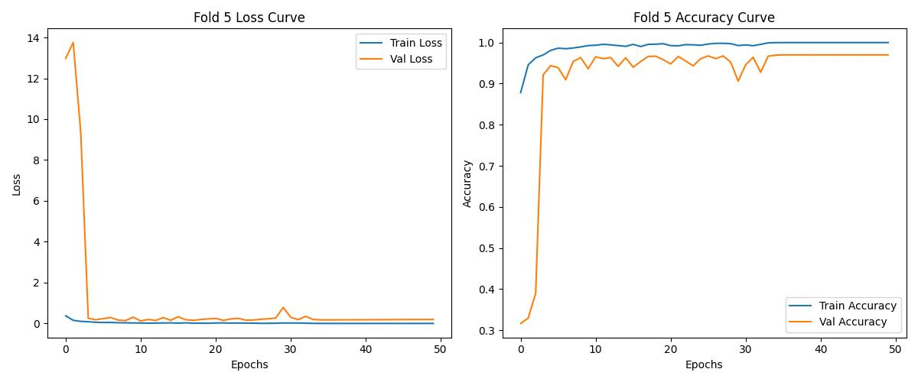
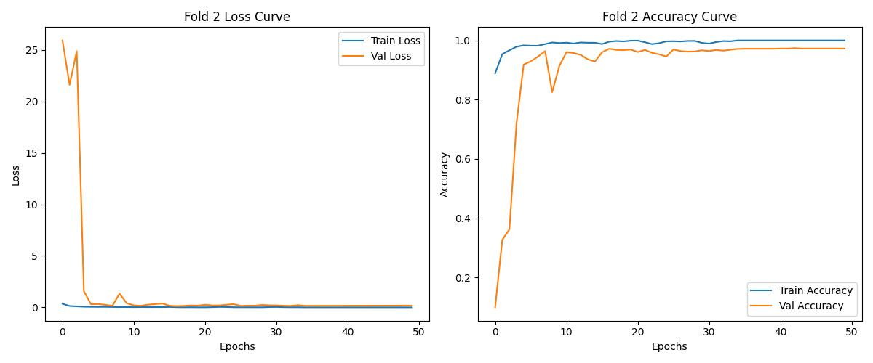
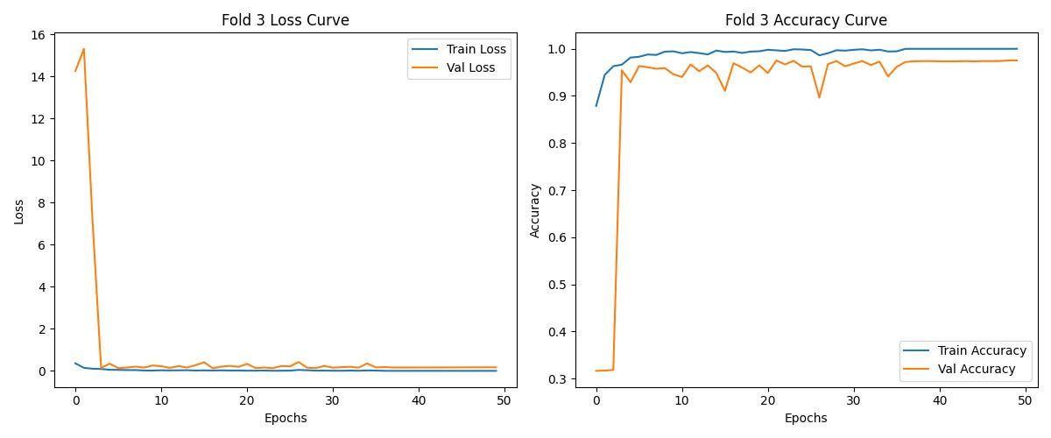
ResNet-50[1], without pre-trained weights
Fold | Test Loss | Test Acc | Best Val Acc | Best Epoch
1 | 0.3706 | 0.9557 | 0.9701 | 29
2 | 0.3321 | 0.9557 | 0.9740 | 43
3 | 0.2979 | 0.9589 | 0.9753 | 22
4 | 0.2757 | 0.9526 | 0.9694 | 19
5 | 0.3301 | 0.9526 | 0.9701 | 36
Overfitting easily, due to the large amount of weight and training parameters.
[1] He, Kaiming, et al. "Deep residual learning for image recognition." Proceedings of the IEEE conference on computer vision and pattern recognition. 2016.

Slide 3
Real-Time Computation:
Self-designed shallow network with few layers.
Imbalanced Dataset:
Focal Loss (works well on binary classification)
Imbalanced-Learn (Random_Over_Sampler, python library)
Data Augmentation (augmentation layer/python library)
Weighted Loss function
Prevent-Overfitting:
Early Stopping
Dropout Layer

Slide 4
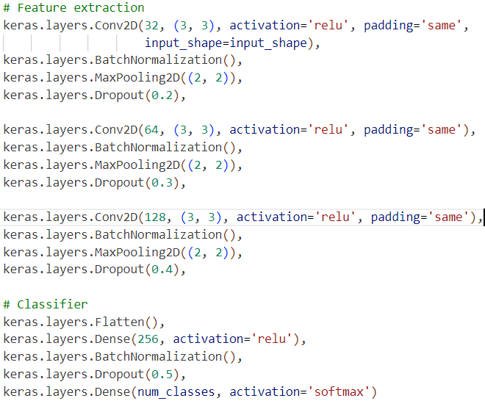
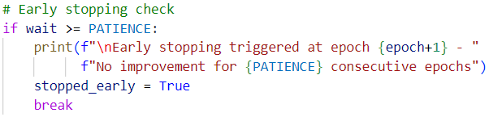
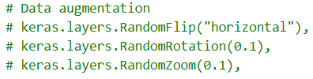
Real-Time Computation:
Shallow Network
Dropout
Early Stopping to monitor the best validation accuracy
Imbalanced Dataset:
Data Augmentation (with keras.layers)

Slide 5
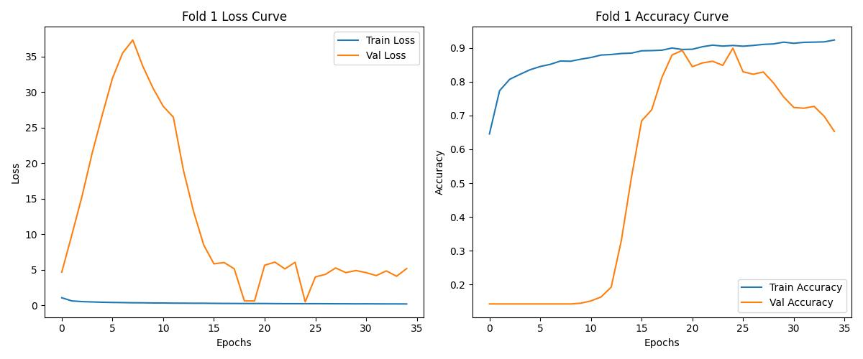
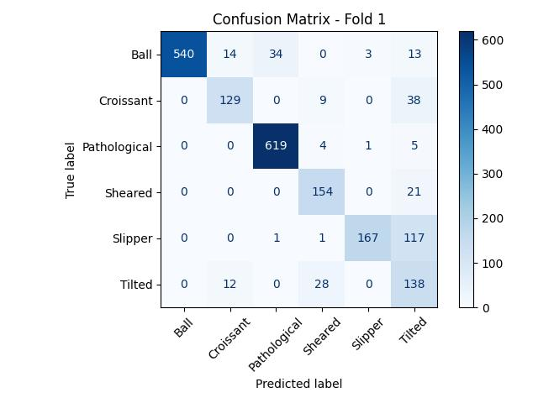
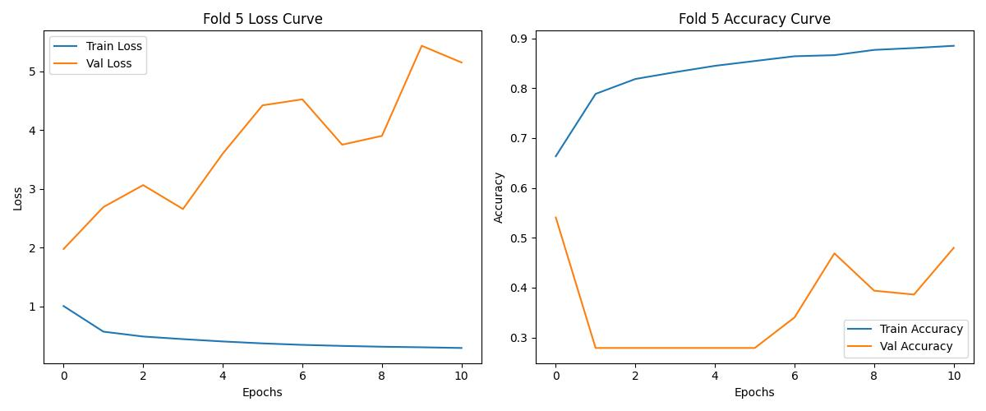
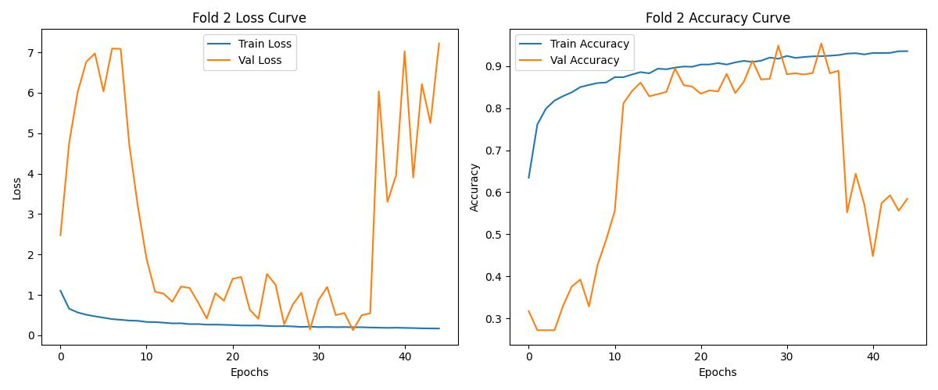
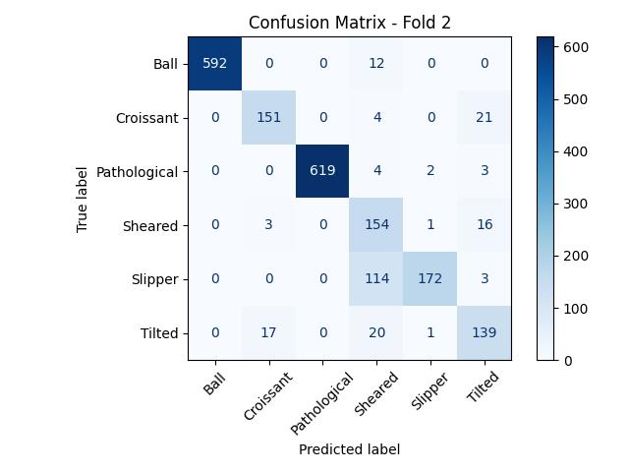
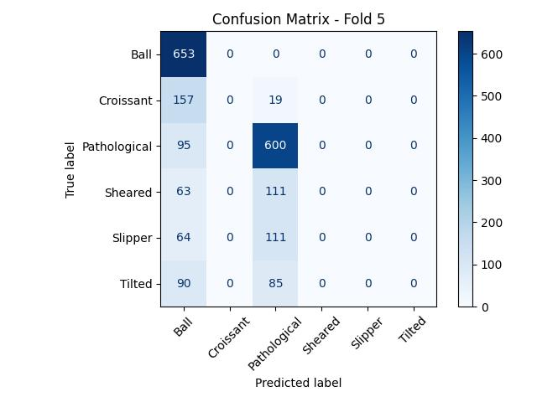
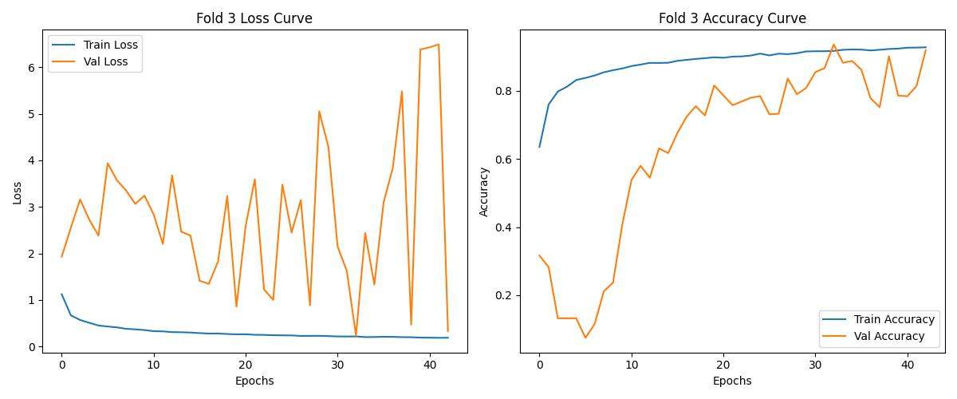
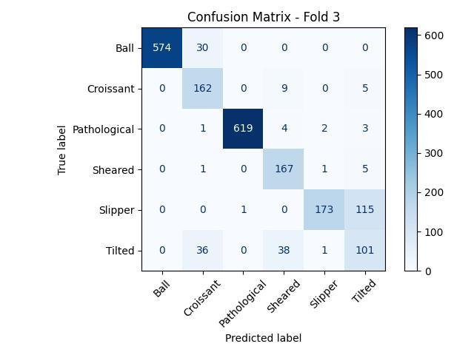
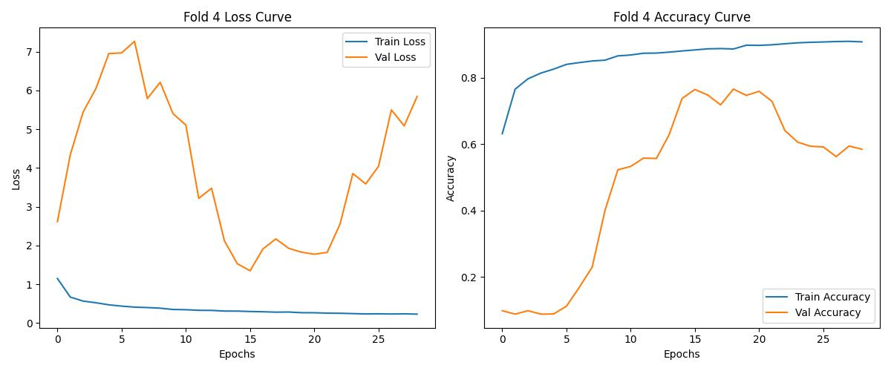
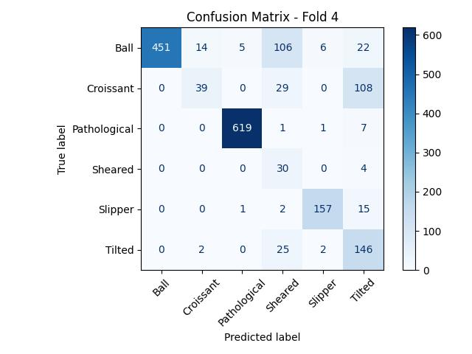
Fold | Best Val Acc | Best Epoch | Test Loss | Test Acc | Mean Acc
1 | 0.8991 | 25 | 3.5158 | 0.8530 | 0.8077
2 | 0.9538 | 35 | 3.1312 | 0.8921
3 | 0.9362 | 33 | 2.8009 | 0.8770
4 | 0.7656 | 19 | 1.0204 | 0.8047
5 | 0.5407 | 1 | 1.6399 | 0.6118

Slide 6

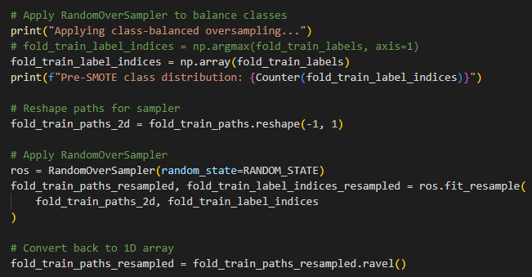

Imbalanced Learning Library (random-over-sampler)

Slide 7
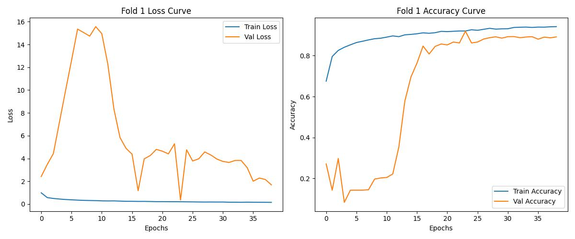

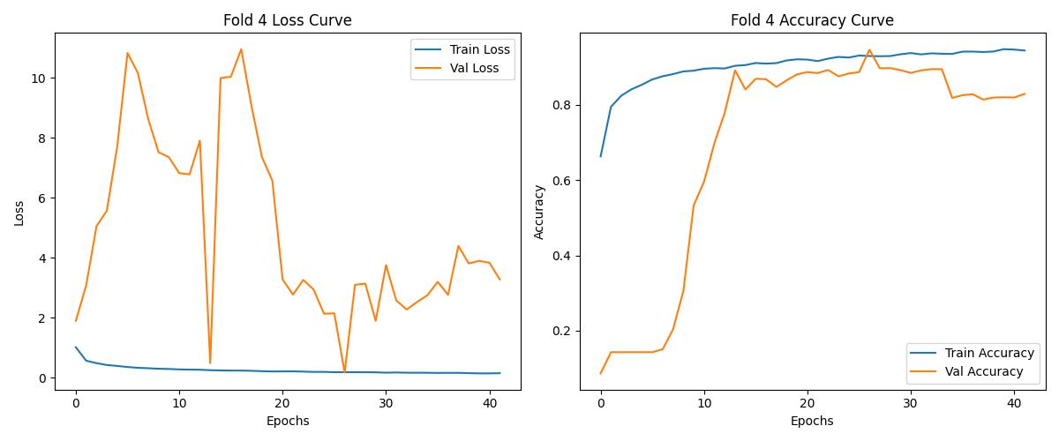

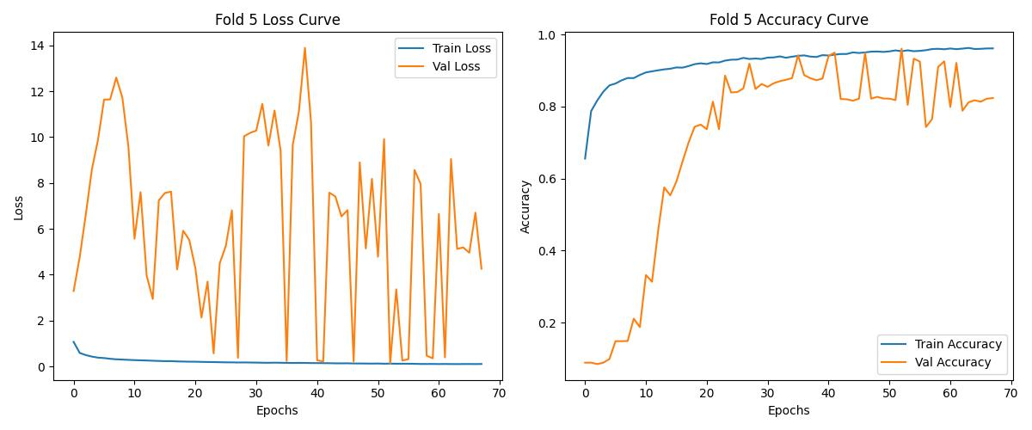
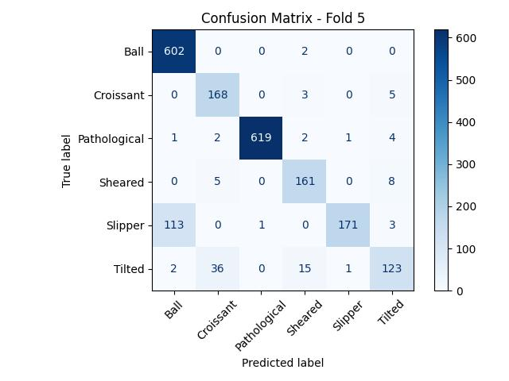
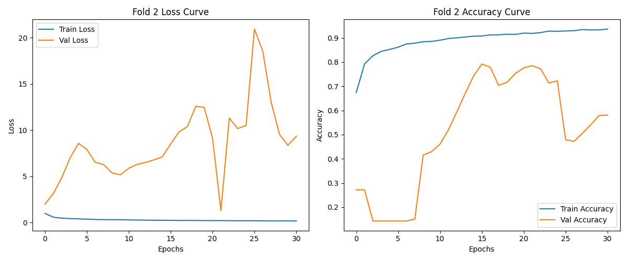
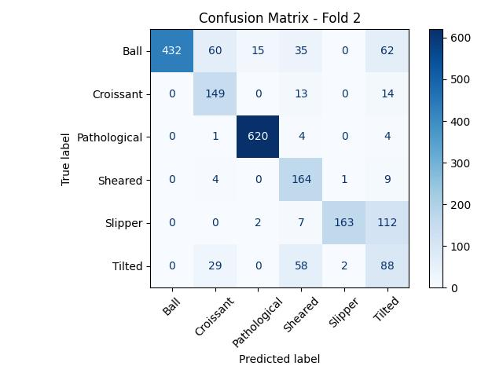
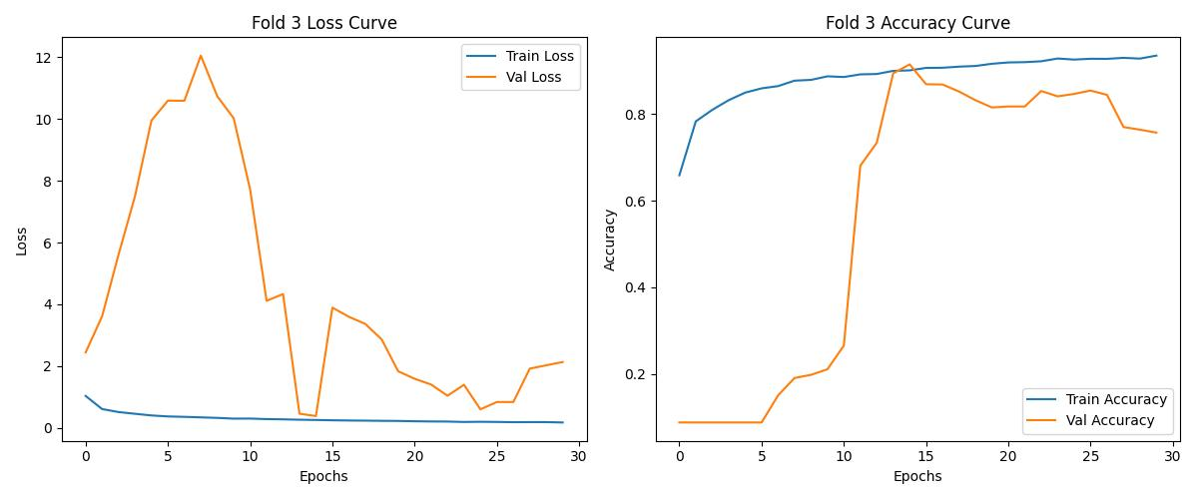
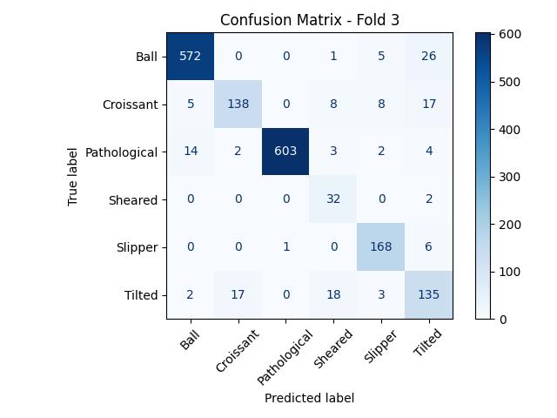
Fold | Best Val Acc | Best Epoch | Test Loss | Test Acc | Mean Acc
1 | 0.9193 | 24 | 4.5902 | 0.8662 | 0.8705
2 | 0.7919 | 16 | 11.7136 | 0.7891
3 | 0.9147 | 15 | 0.3825 | 0.9196
4 | 0.9466 | 27 | 7.3150 | 0.8774
5 | 0.9466 | 53 | 2.5530 | 0.9004

Slide 8
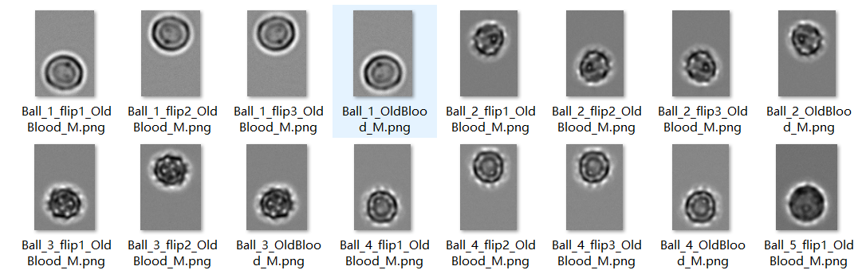
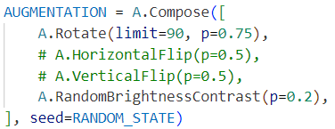
Redundant Dataset
Original Red Blood Cell
Vertical Flip
Horizontal Flip
Horizontal Flip + Vertical Flip
Data Augmentation (implemented by using the albumentations library)

Slide 9
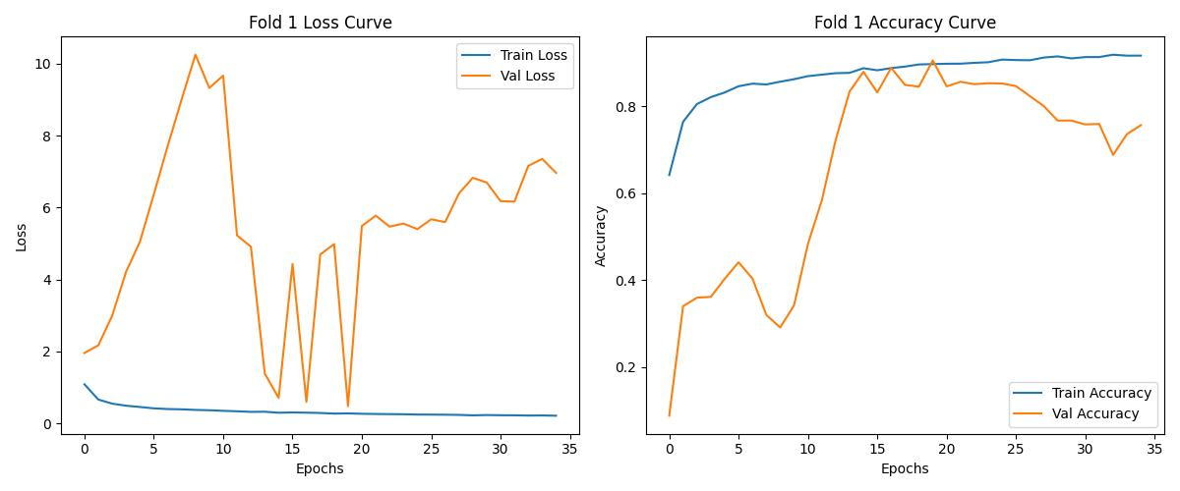

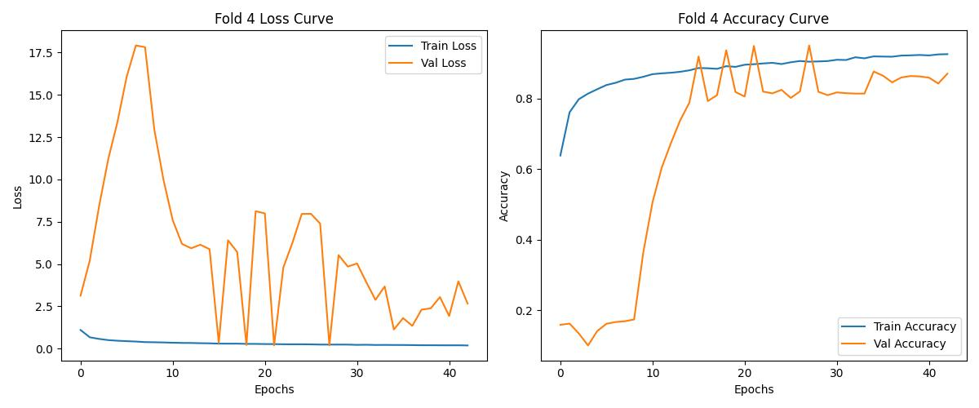
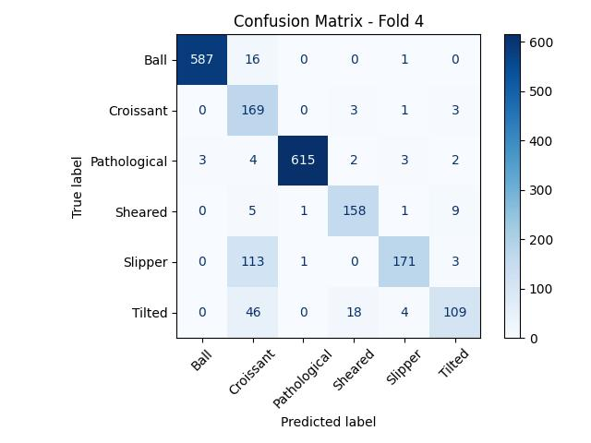
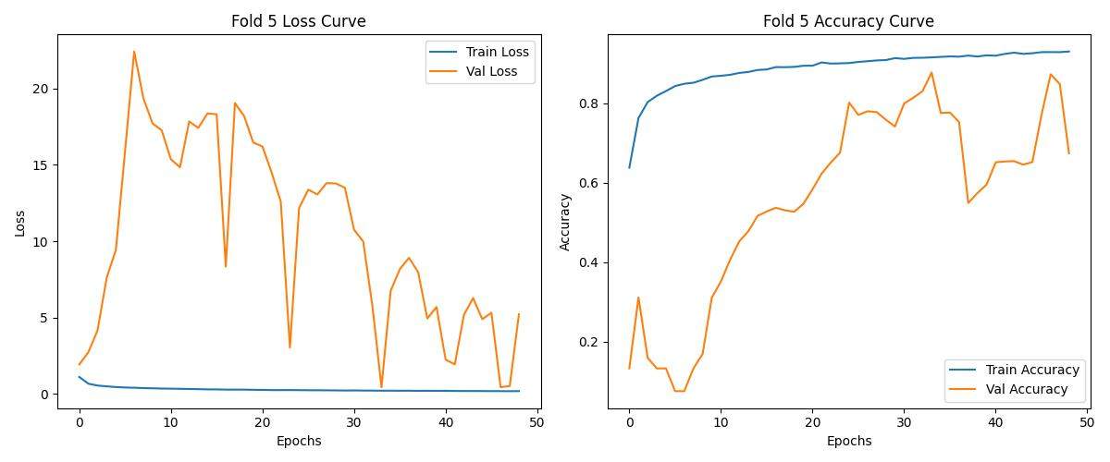
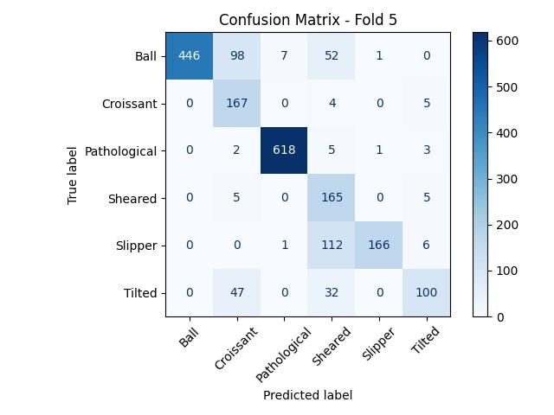
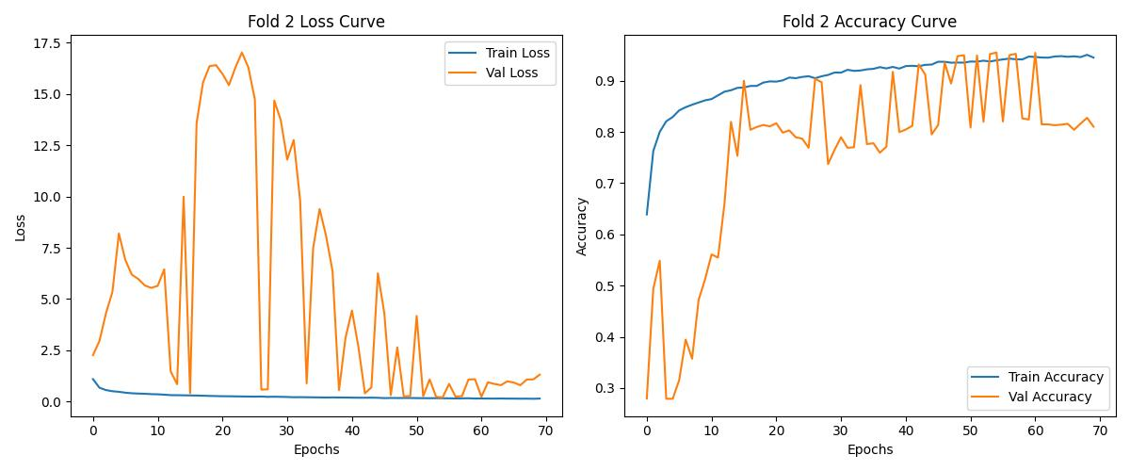

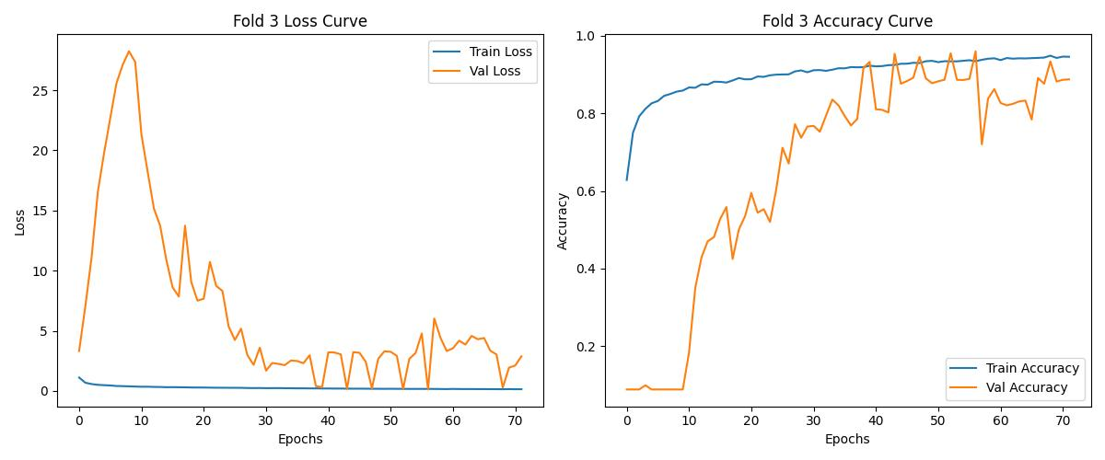

Fold | Best Val Acc | Best Epoch | Test Loss | Test Acc | Mean Acc
1 | 0.9056 | 20 | 6.3802 | 0.8516 | 0.8682
2 | 0.9551 | 55 | 0.7884 | 0.8965
3 | 0.9603 | 57 | 3.8606 | 0.8979
4 | 0.9505 | 28 | 4.7643 | 0.8833
5 | 0.8776 | 34 | 8.7475 | 0.8115

Slide 10
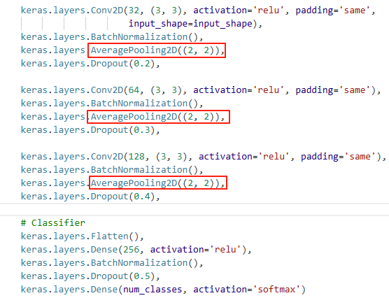
AveragePool2D
Replace the MaxPooling2D with the AveragePooling2D:
The empirical experimental shows, max-pool can always brought the information loss after computation (but can extract the most important information from the edge).
Instead, the average pool will preserve the information (extract information more smoothly) from the kernel scale.

Slide 11
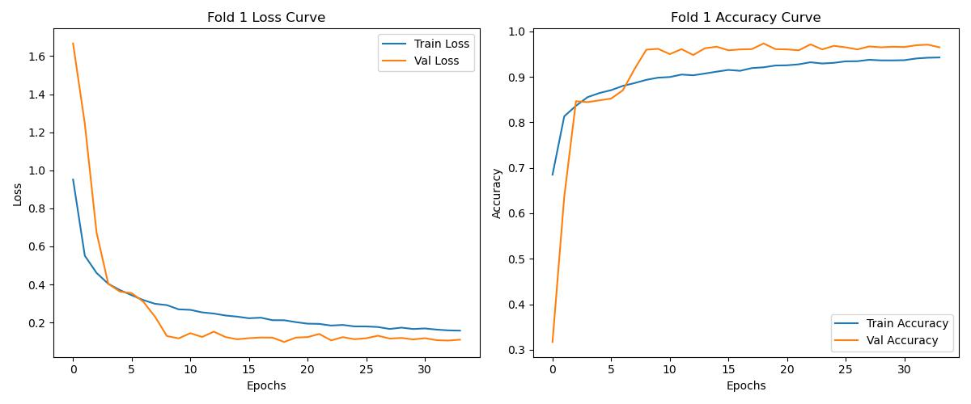
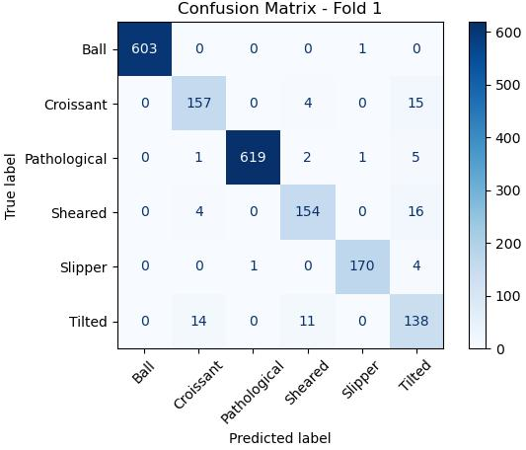
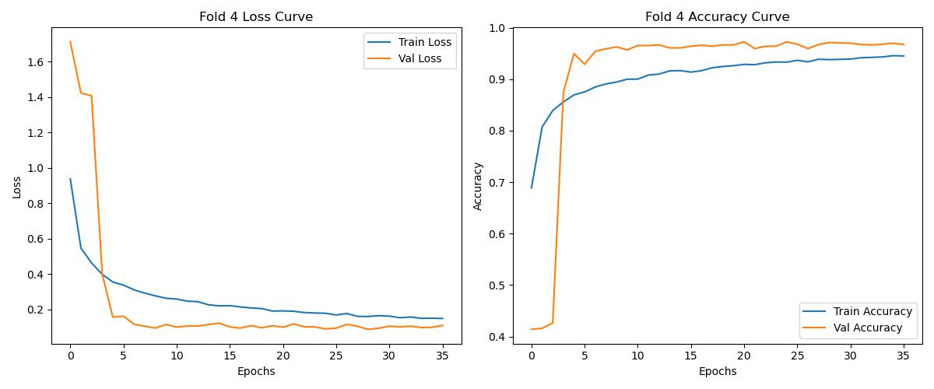

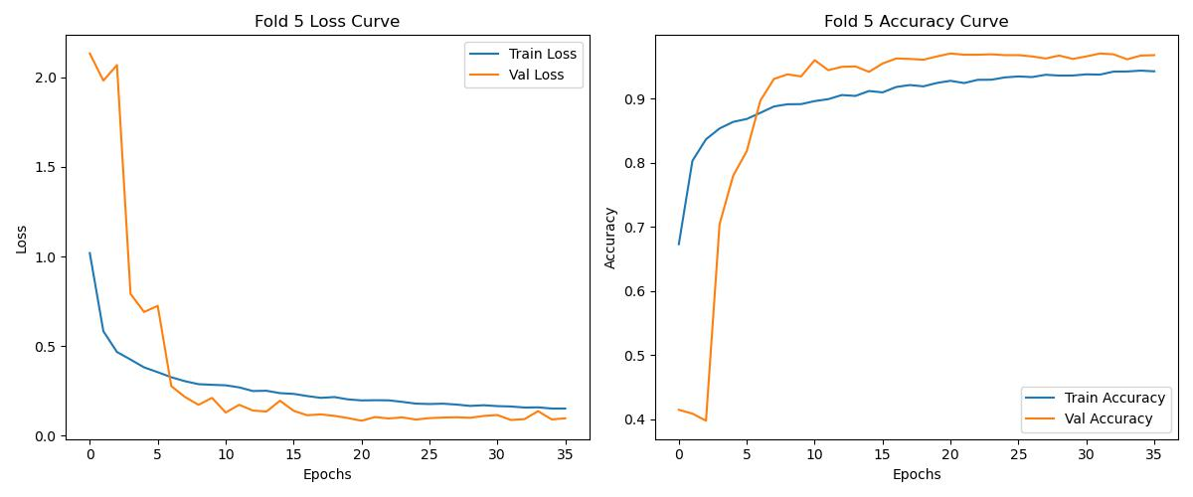

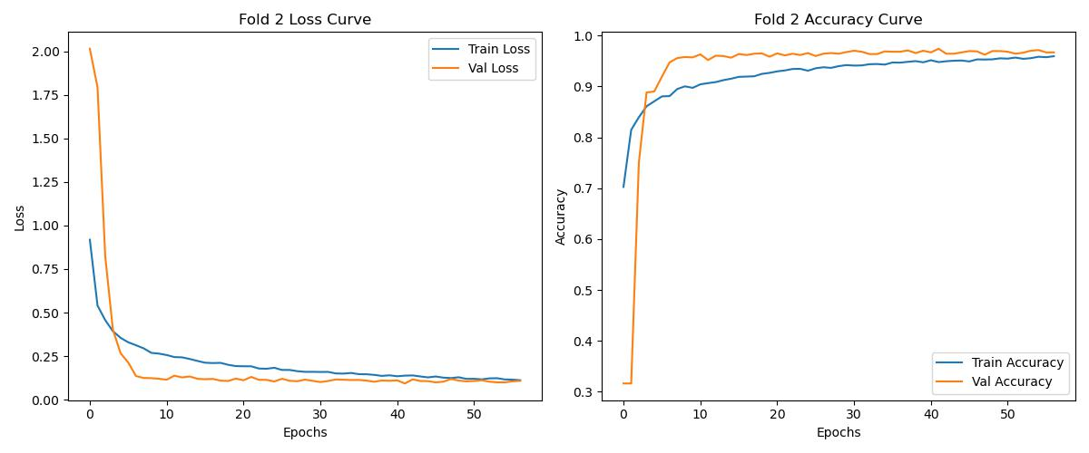

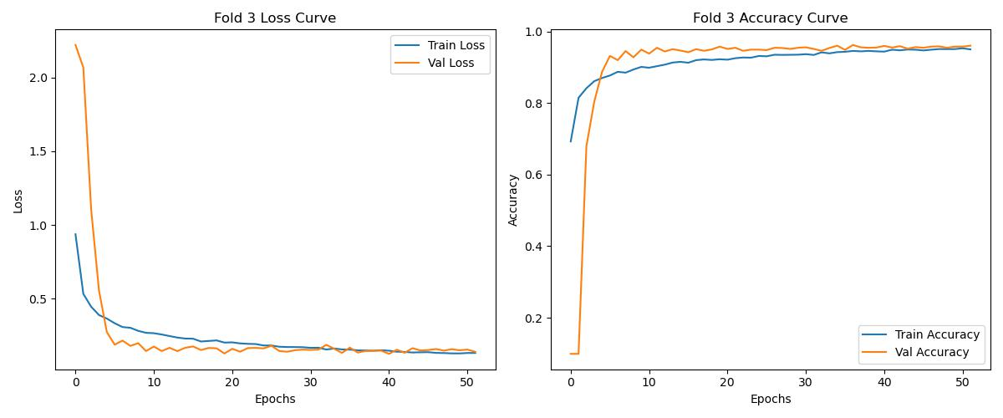

Fold | Best Val Acc | Best Epoch | Test Loss | Test Acc | Mean Acc
1 | 0.9733 | 19 | 0.1524 | 0.9589 | 0.9580
2 | 0.9740 | 42 | 0.1690 | 0.9594
3 | 0.9622 | 37 | 0.1796 | 0.9573
4 | 0.9727 | 21 | 0.1612 | 0.9583
5 | 0.9707 | 21 | 0.1629 | 0.9563

